Slide 1
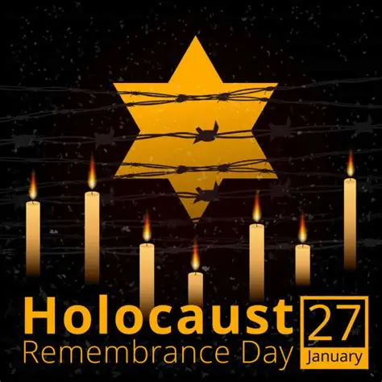
Holocaust Memorial Day

Slide 2
Keywords
Holocaust – A time during World War Two when millions of people, especially Jewish people, were treated very badly and killed because of who they were.
Remember – To think about people and events from the past so they are not forgotten and we can learn from them.
Respect – Treating others kindly and fairly, even when they are different from us.

Slide 3
Why we remember the Holocaust.
Holocaust Memorial Day is marked every year on January 27th. It is a time to remember the six million Jewish people who were murdered during the Holocaust, as well as millions of other people who were persecuted and killed by the Nazi regime and in later genocides. The date was chosen because it marks the liberation of Auschwitz-Birkenau concentration camp, one of the most well-known Nazi camps, in 1945.
The Holocaust shows what can happen when prejudice, racism and hatred are allowed to grow without challenge. Ordinary laws and systems were used to exclude, control and harm people simply because of who they were. Learning about these events helps us understand the importance of human rights, democracy and the rule of law and also why these values must be protected.

Slide 4
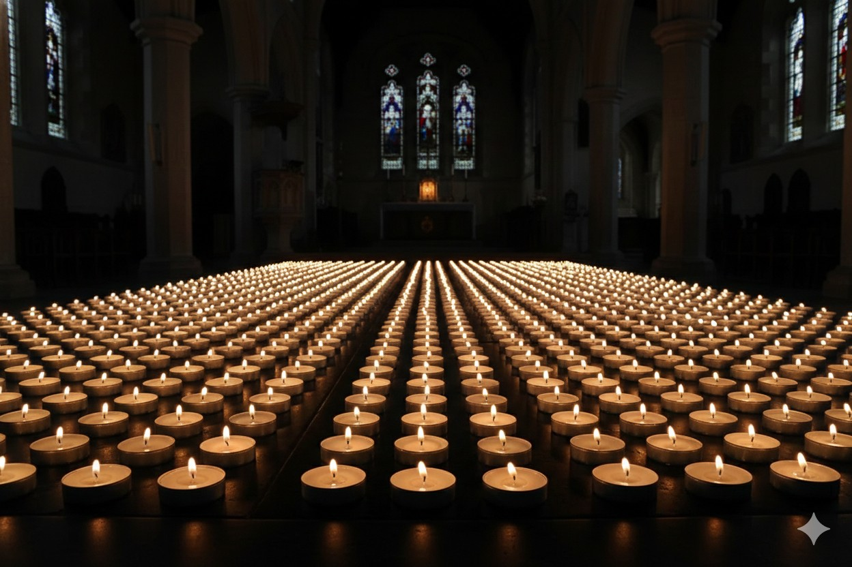
Why we remember the Holocaust.
Holocaust Memorial Day is not only about the past, but also about our responsibilities today. It encourages us to challenge discrimination, stand up for others and think carefully about our own choices and actions.
By remembering what happened, we are reminded of the importance of building a society based on respect, fairness and inclusion for everyone.

Slide 5


