Slide 1
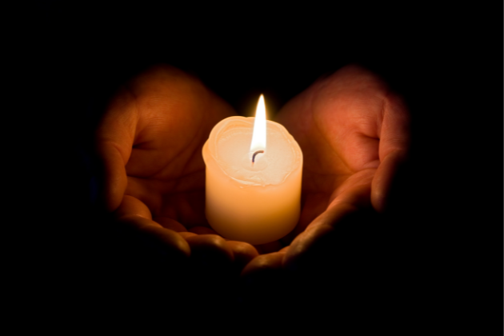
Holocaust Memorial Day
Notes:
https://www.twinkl.co.uk/resource/t3-e-215-holocaust-memorial-display-pack

Slide 2
Keywords
Holocaust – A time during World War Two when millions of people, especially Jewish people, were treated very badly and killed because of who they were.
Remember – To think about people and events from the past so they are not forgotten and we can learn from them.
Respect – Treating others kindly and fairly, even when they are different from us.

Slide 3
Why we remember the Holocaust.
Holocaust Memorial Day is a special day held every year on January 27th. On this day, people remember the millions of people who were treated unfairly and lost their lives during the Holocaust in World War Two. The date was chosen because it marks the day in 1945 when the Auschwitz concentration camp was liberated.
It is a time to remember those who were hurt and to make sure their stories are never forgotten.
On Holocaust Memorial Day, we also think about how we can make the world a kinder and fairer place today. It reminds us to:
stand up for others
treat everyone with respect
challenge bullying, hatred and discrimination.
By learning from the past, we can help build a future where everyone feels safe, valued, and included.

Slide 4


