Slide 1

New Woodlands’ Nurturing School journey:

Slide 2
Work in your tutor groups to discuss each of the principles and what they mean to you.
Next, work together to create a display for your classroom which displays the nurture principles and what they mean to you.
I have included some examples to give you ideas.
Be creative as these will be displayed all year round.

Slide 3
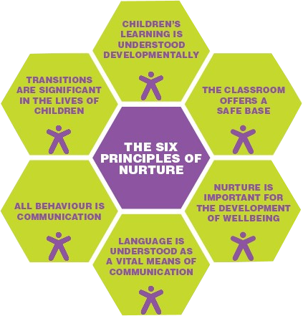
We learn what we are ready to learn.
We are safe in our classroom.
We are told what we will be doing every day.
Our teachers know when we are not happy and they try to help us.
Our teachers like us and they listen to us. This makes us feel good.
We are encouraged to use our words to tell people what we want.

Slide 4
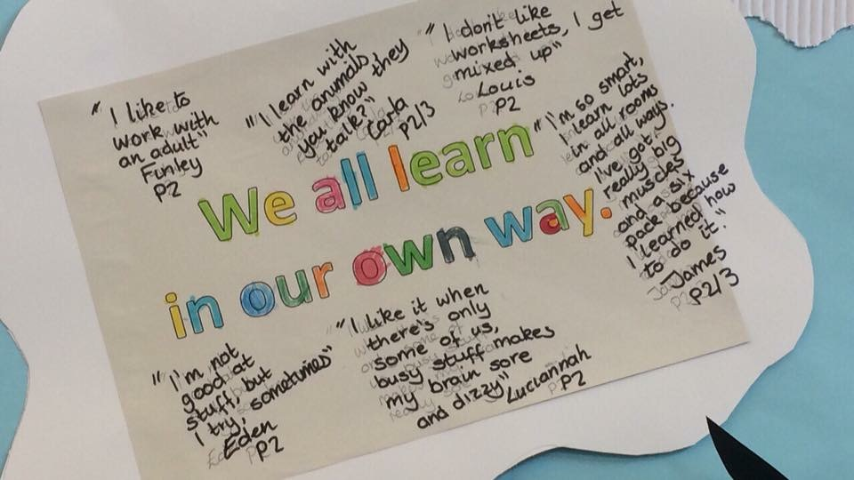
Learning is understood developmentally
We learn what we are ready to learn.
Individual targets
Personalised support
Movement breaks
Sensory tools

Slide 5
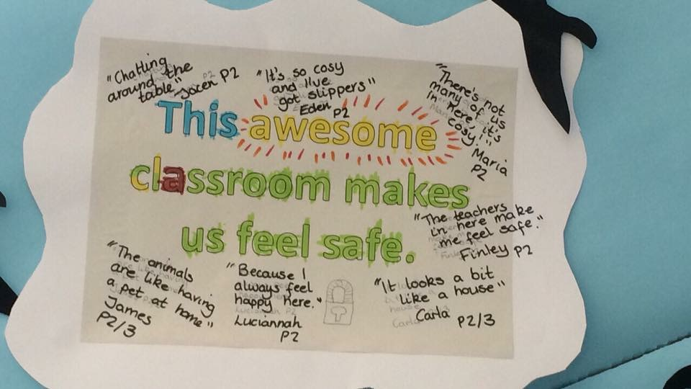
The Classroom Offers a Secure Base
We are safe in our classroom.
Sofas
Trusted adults
Small class sizes
cameras
Behaviour policy

Slide 6
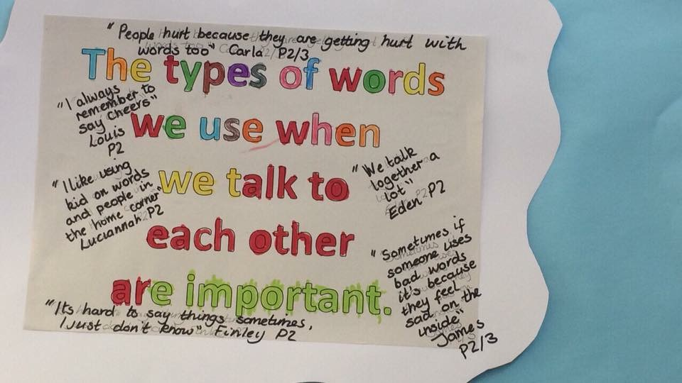
Language as a Vital Means of Communication
We are encouraged to use our words to tell people what we want.
Lots of adults to listen
True time
Speech and language therapists
Zones of regulation
Behaviour mentors
Therapists
Lego therapy
School council

Slide 7
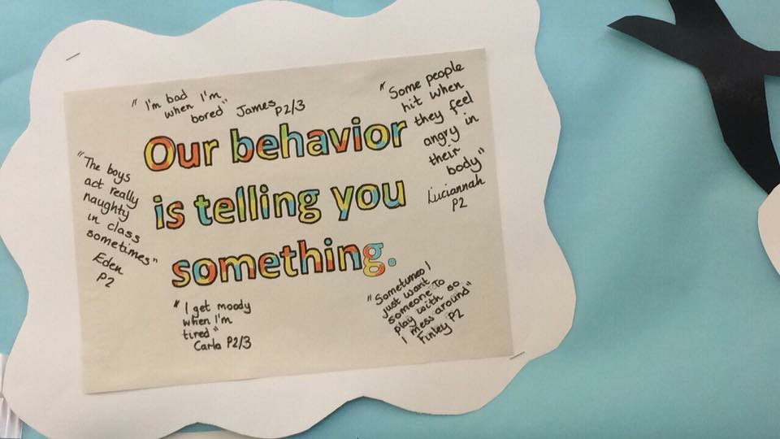
All Behaviour is Communication
Our teachers know when we are not happy and they try to help us.
Zones of regulation
Behaviour mentors
Reflection room
Therapy

Slide 8
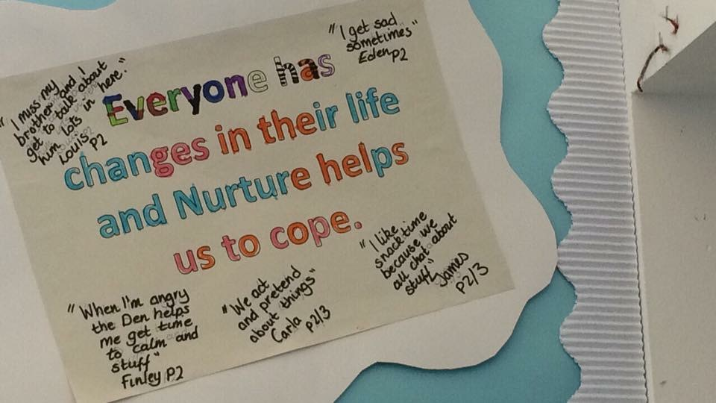
The Importance of Transition in the live of children and young people
We are told what we will be doing every day.
Visual timetables
Teaching assistants
Social stories
Zones of regulation check-ins
Breakfast

Slide 9
The Importance of Nurture for the development of wellbeing
Our teachers and teaching assistants like us and they listen to us.
This makes us feel good.
Positive relationships with adults
Praise
Rewards
Nurture helps us to feel good on the inside.
Interhouse
Celebration assemblies
Breakfast
Trips and visits
PSHE lessons
Therapy

Slide 10
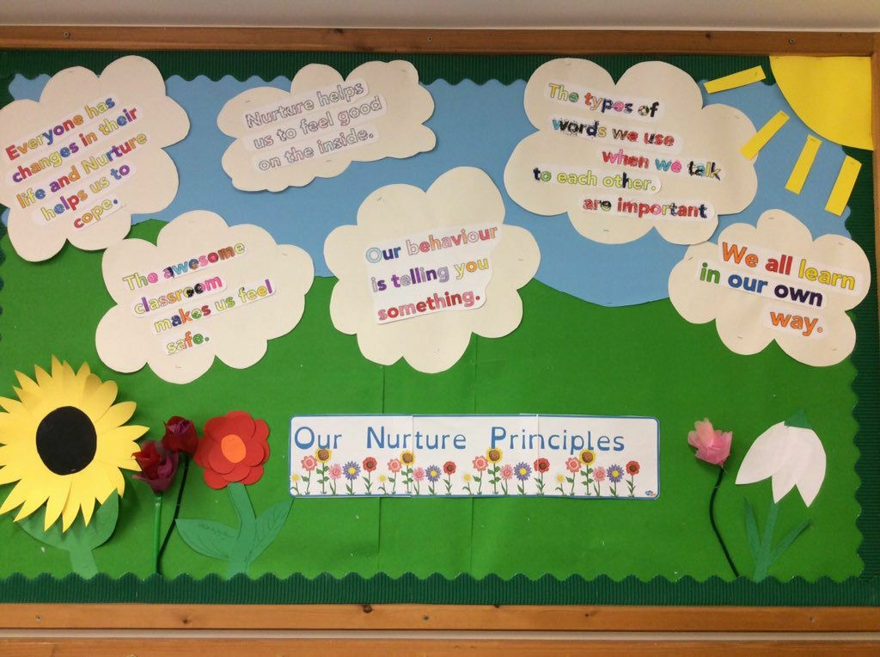

Slide 11
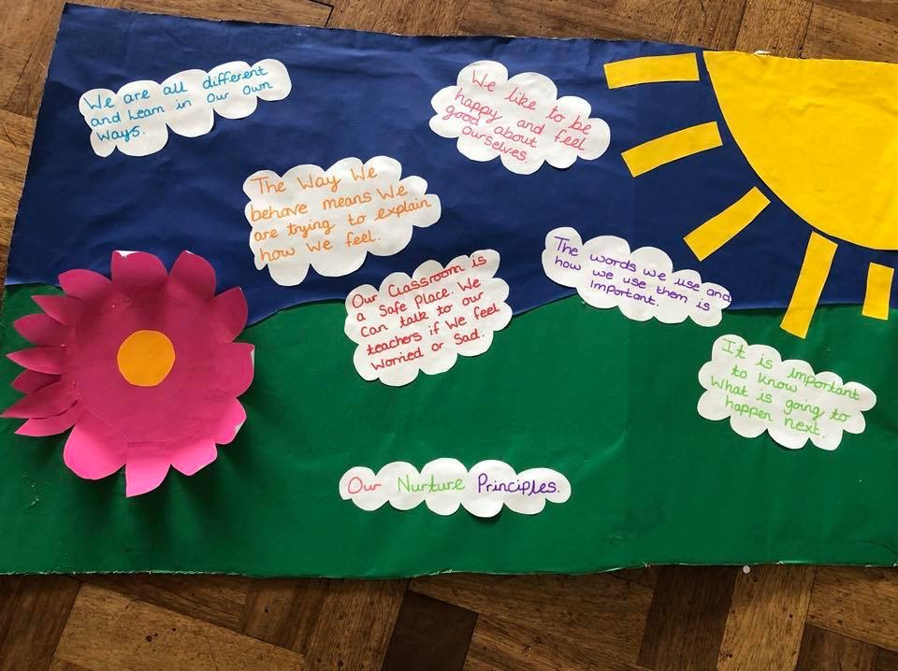
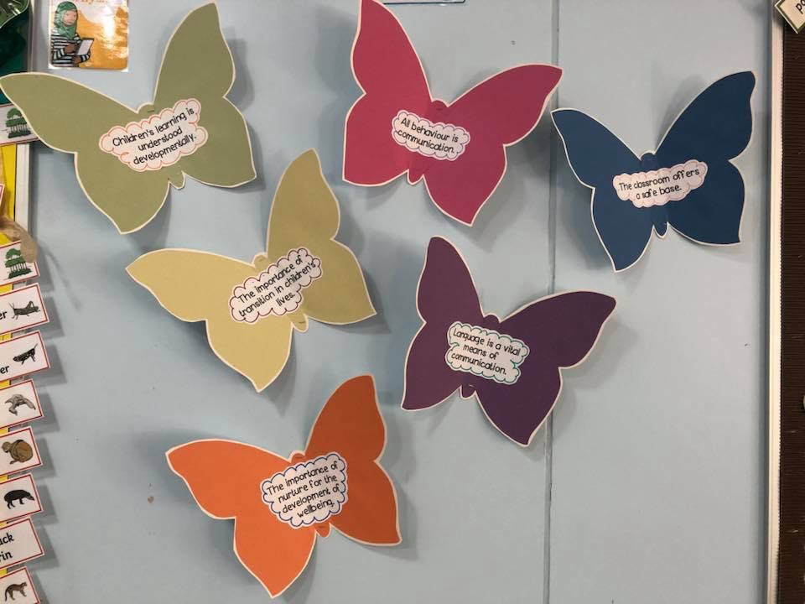
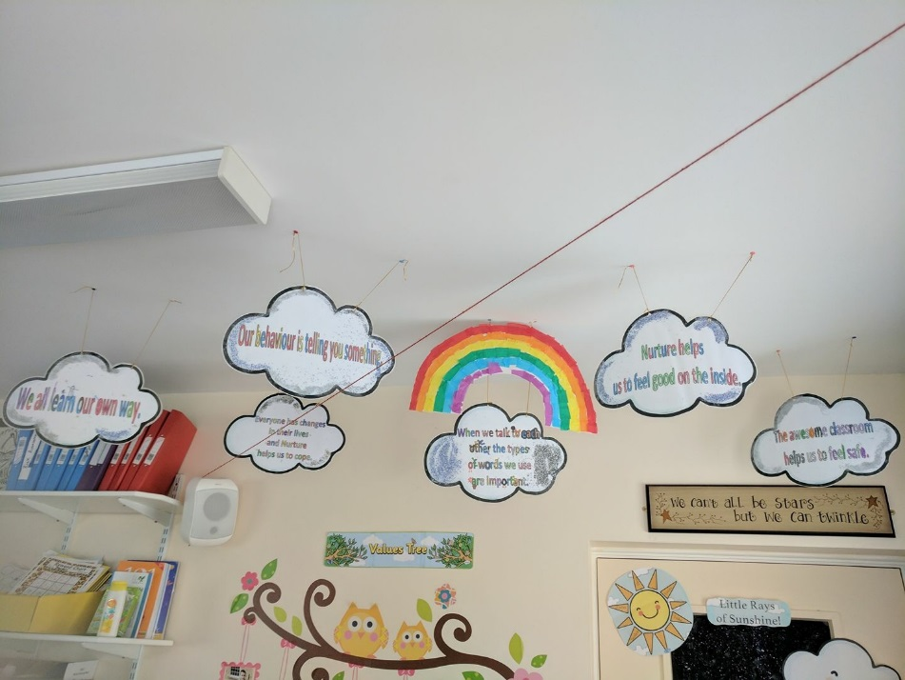
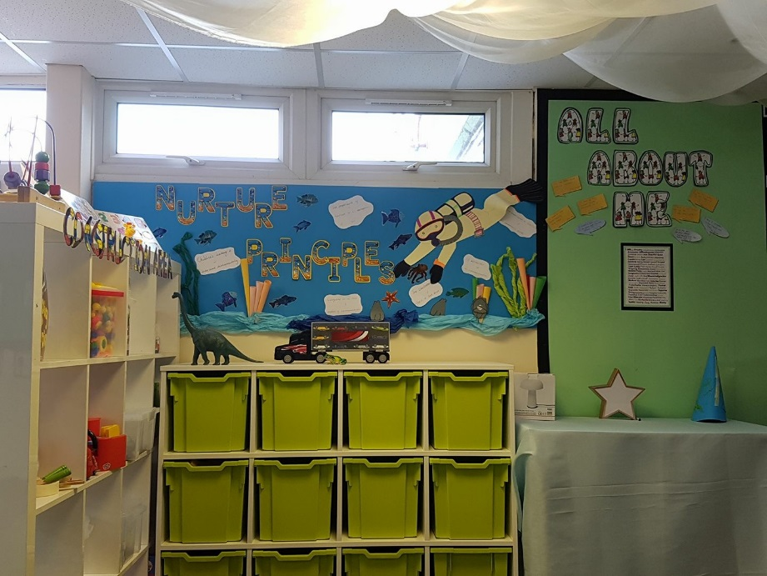

Slide 12


