Slide 1

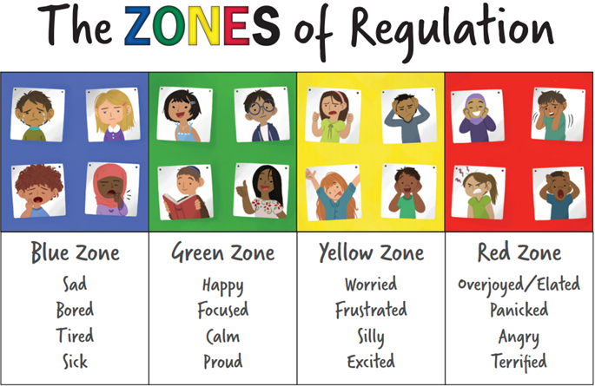
Welcome! ☺
Now: Please settle in your seat.
Next: Please answer your name when the register is called.
Then: Think about the zones of regulation - what zone are you in? Can we support?

Slide 2


114532
Black history month
Notes:
Black British History - https://www.bbc.co.uk/news/newsbeat-52939694

Slide 3
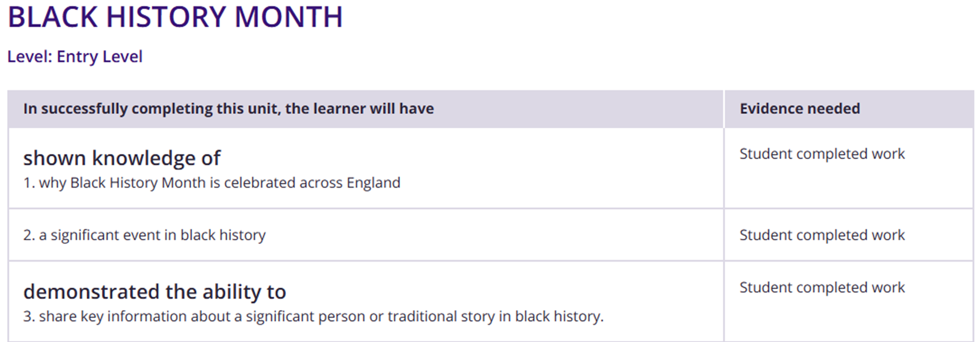
Notes:
Video and gap fill exercise with discussion.
Timeline of some significant events - students to select one of them to write about.
10 famous people who have been significant to Black History in the UK. Create a mini fact file on each person.

Slide 4
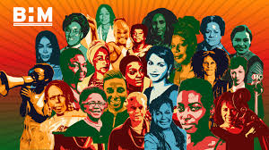


Lessons from Black History
“Standing firm in power and pride”
Notes:
David Olusoga (Black British History) - https://www.youtube.com/watch?v=Ut5gtrezN4E

Slide 5

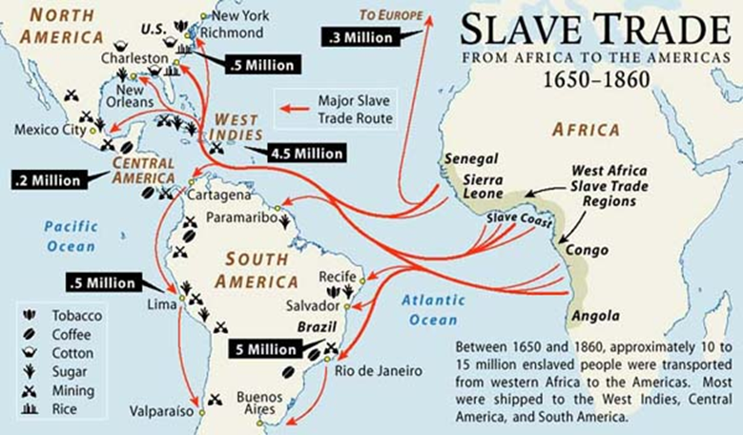
17/10/25
LO: To explore the legacy of the Transatlantic Slave Trade.
Now: Write and underline the date - remember on the right of the top line.
Next: Copy out the learning objective.
Then: Write this information into your book.
Slavery has existed in many parts of the world for thousands of years, but the Transatlantic Slave Trade was different. It became a large, organised system based on race and profit, where millions of Africans were captured and forced to work in the Americas. This made it one of the most brutal and far-reaching systems in history.
Notes:
Videos:
Life Aboard a Slave Ship - https://www.youtube.com/watch?v=PmQvofAiZGA
A History of Slave Rebellions - https://www.youtube.com/watch?v=qpO2fmbjINc
The Atlantic Slave Trade - https://www.youtube.com/watch?v=3NXC4Q_4JVg
Abolitionism and why some opposed - https://www.youtube.com/watch?v=ITtNDpkW26c
Why British slave owners received compensation - https://www.youtube.com/watch?v=KXLRSoZwzco
Britain’s Legacy of slavery - https://www.youtube.com/watch?v=aQFL-5xf55c

Slide 6
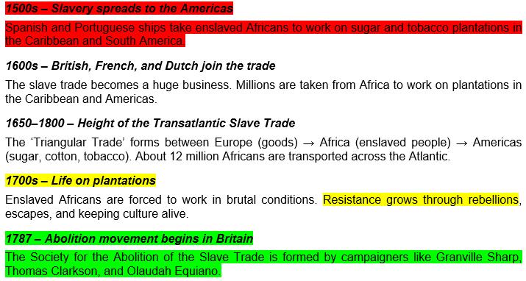
Timeline of the Transatlantic Slave Trade
Now: We will read through the timeline together.
Next: Highlight each of the following periods of time using a different colour for each one. There is an example below
Periods of enslavement Periods of resistance Periods of abolition

Slide 7
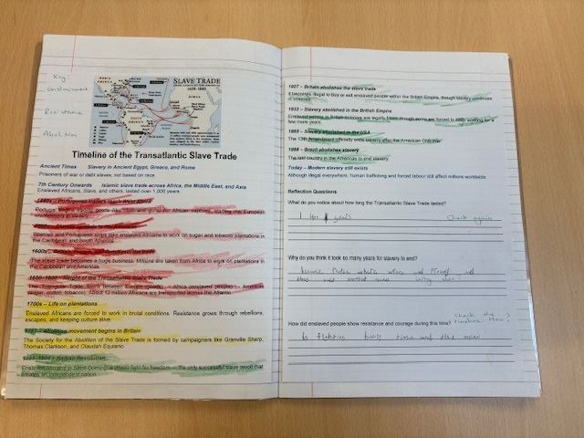
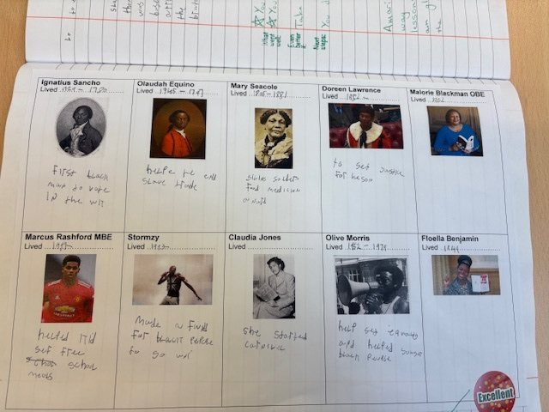
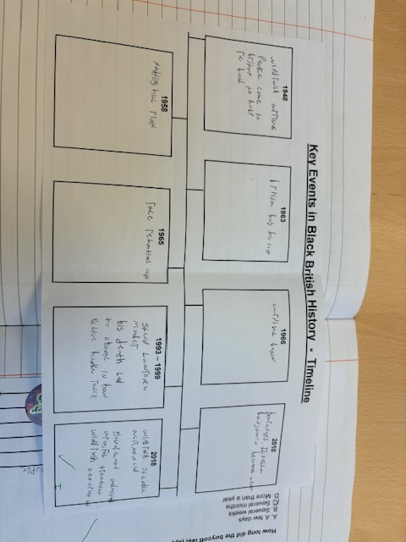

Slide 8

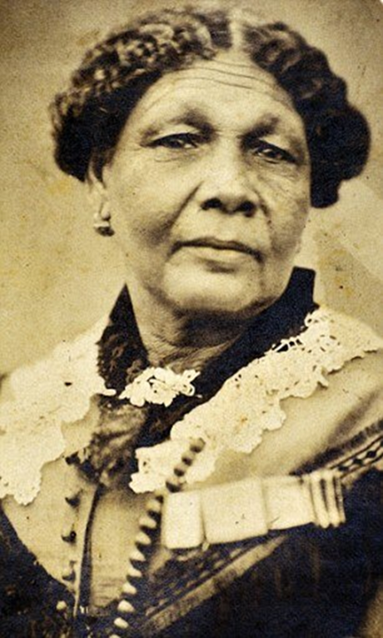
Mary Seacole
“I made up my mind to overcome every obstacle; and never to turn back until I had reached the end.”
How does this quote fit with the idea of “Standing Firm in Power and Pride” from a Christian point of view?
Consider the key words of:
Faith
Imago Dei (in the image of God)
Justice
Perseverance
Notes:
Mary Seacole video - History | KS2 | Assemblies | Mary Seacole | BBC Teach
Why it fits:It shows determination, resilience, and pride, all key ideas in Standing Firm in Power and Pride.It connects well to the RE focus on strength of character and faith in action — standing firm despite hardship.

Slide 9
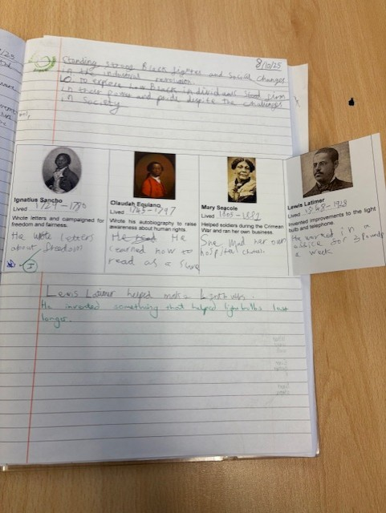
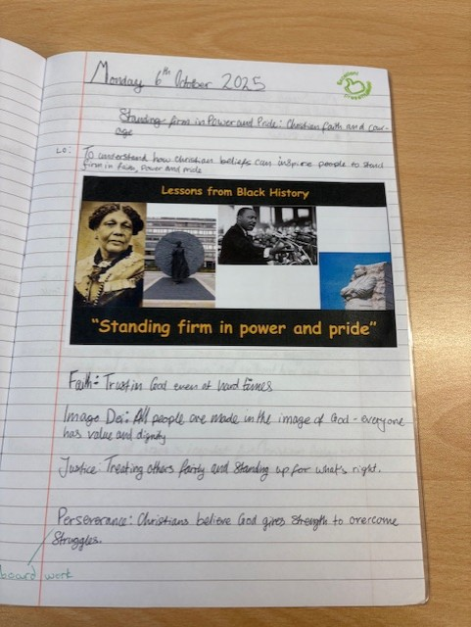

Slide 10
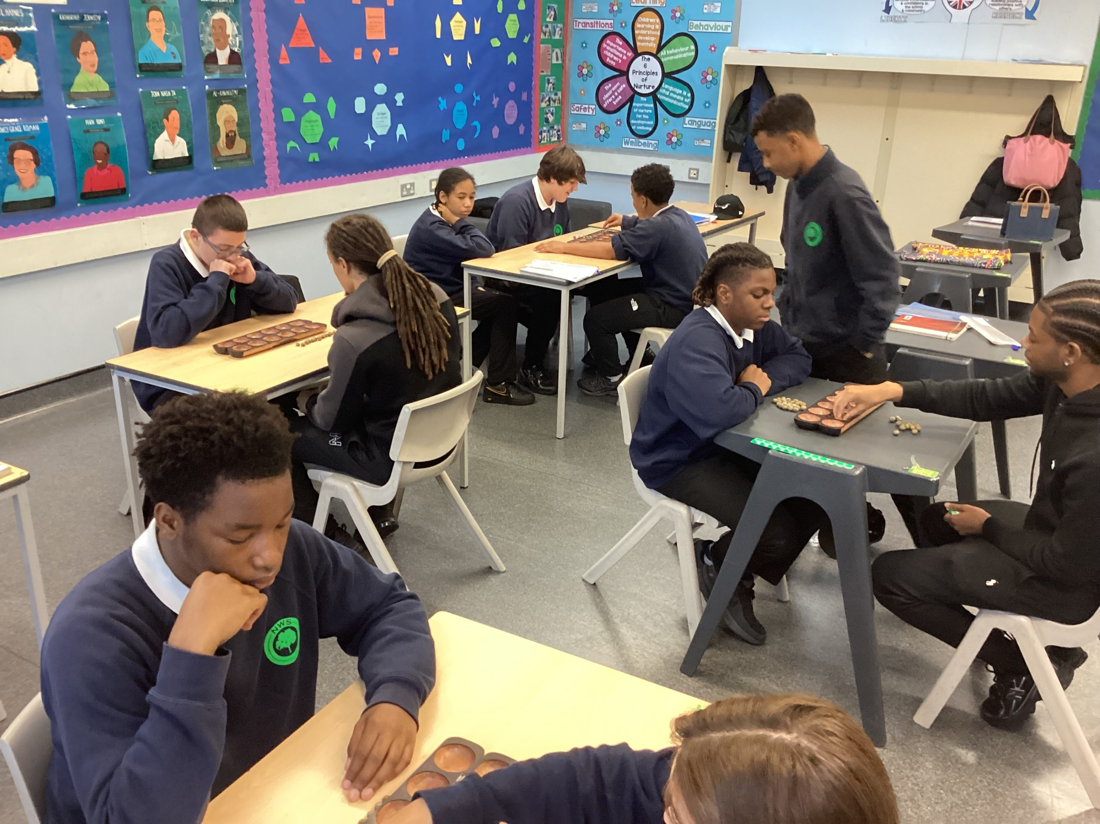
Students playing in math Oware

Slide 11


