Slide 1


Slide 2
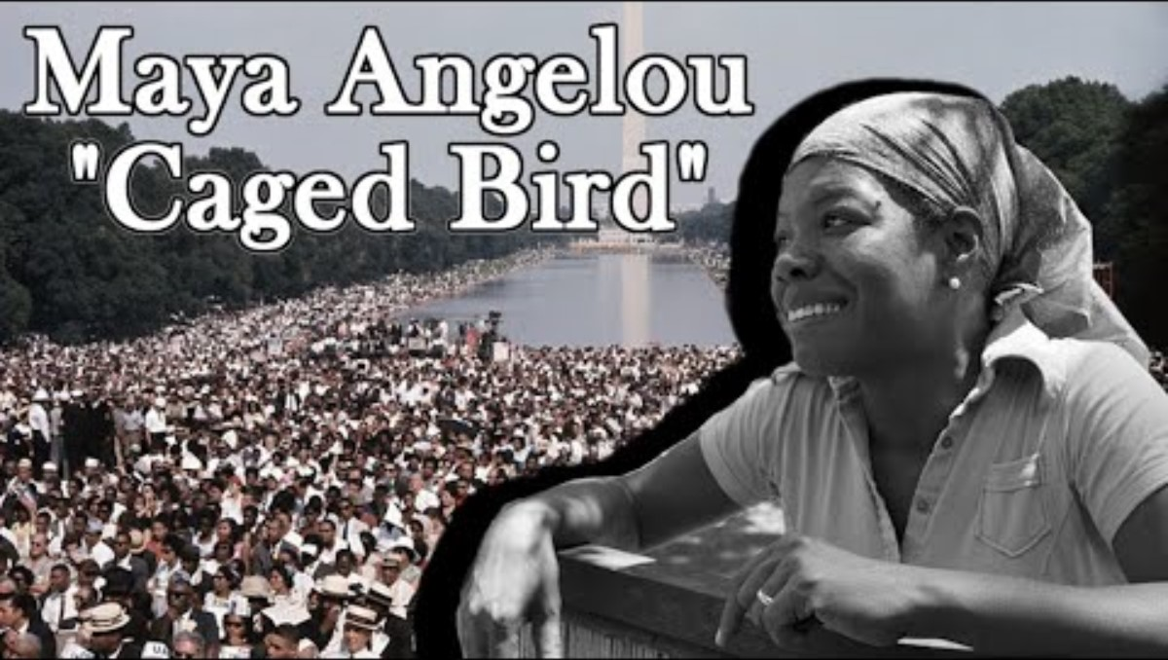

Slide 3
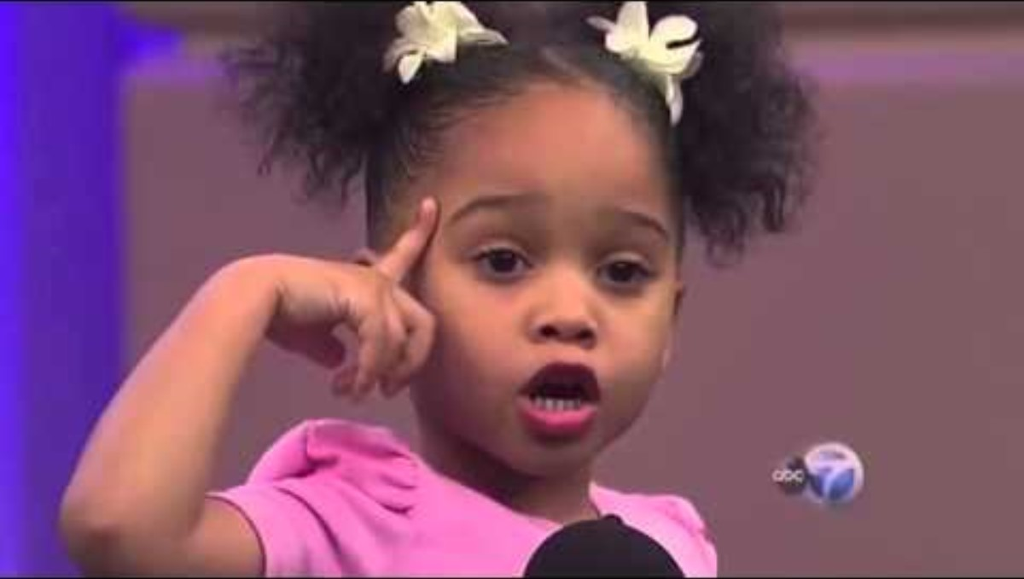

Slide 4
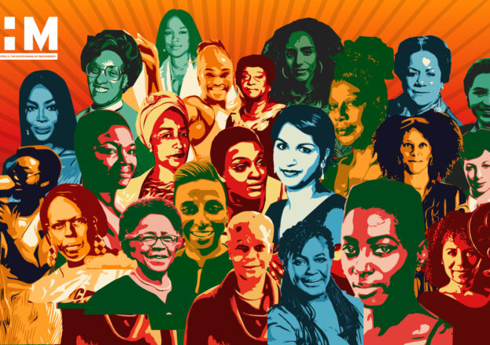
National Black History Month Poetry Competition celebrating black women is an important addition to the Black History Month 2023 celebrations, providing an opportunity to learn about the contributions and achievements of black women while inspiring and empowering future generations.

Slide 5
The context
We want you to learn about and celebrate black women who have made significant contributions in various fields.
You can submit a poem about a pioneering black woman who has made an impact in their chosen field, explaining why she is an inspiration to you.
Remember, the poems don’t have to be about famous people; they can be about members of your family, women who have inspired you in your community, or even about you and your experiences as a woman or young person.
Be creative and have fun with it!

Slide 6
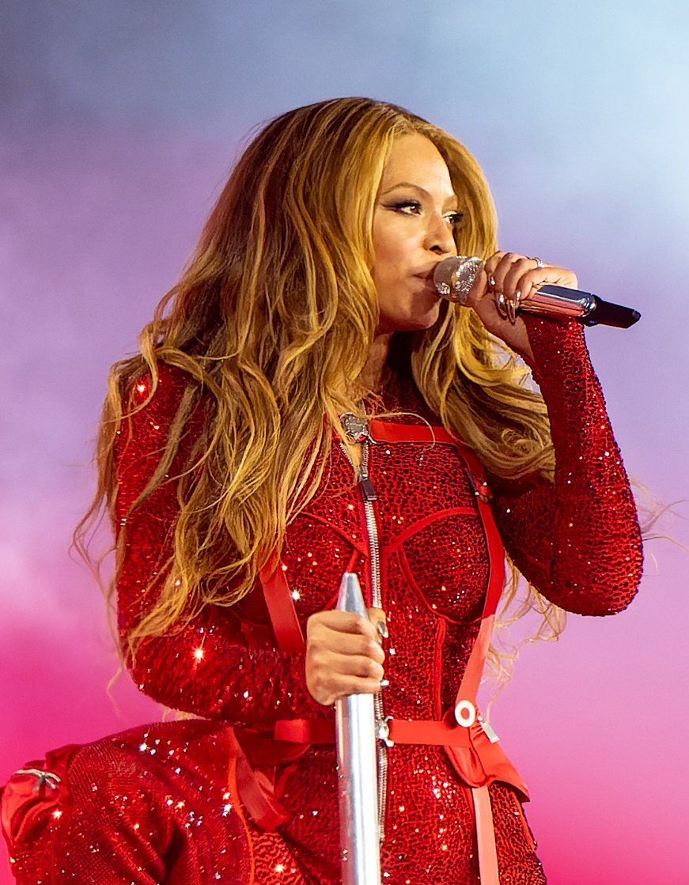
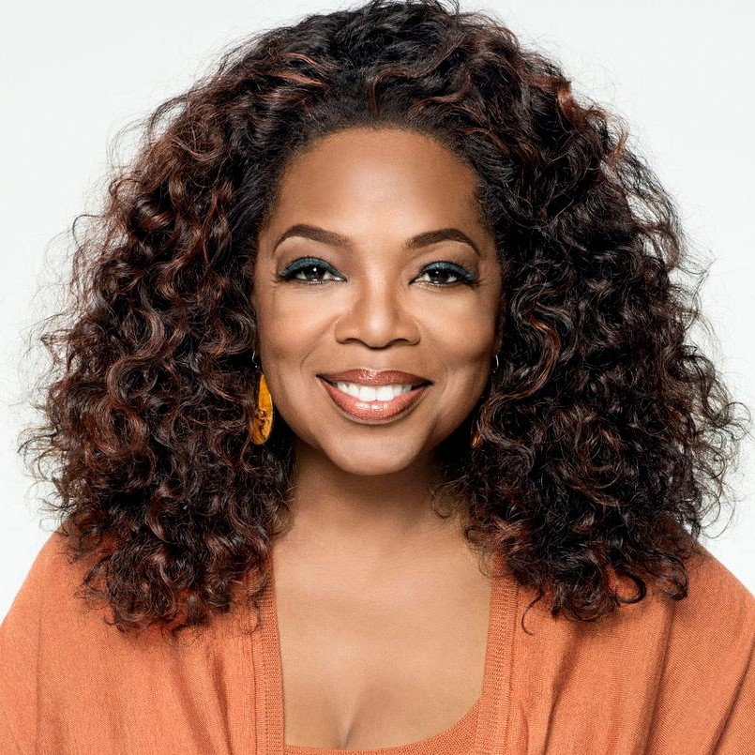
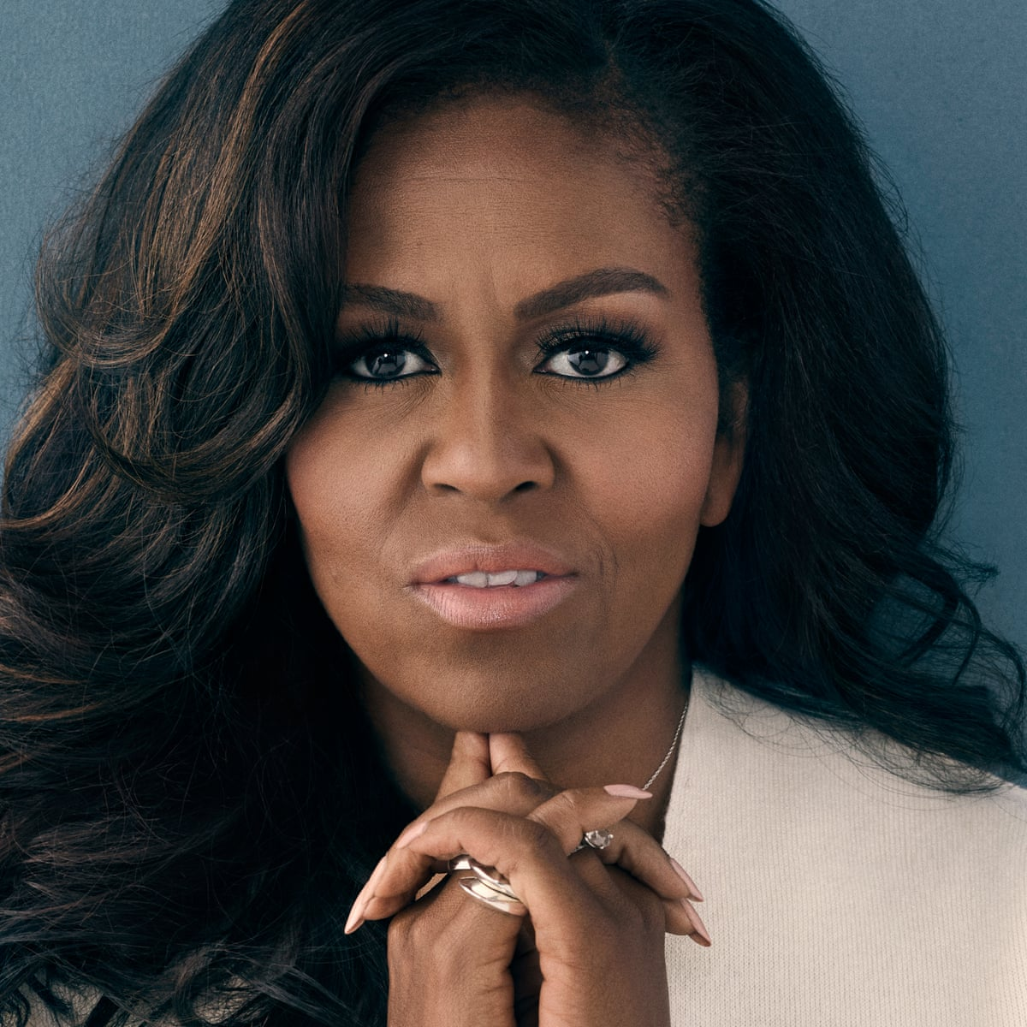
Famous Black Women

Slide 7
Submitting your entry
Selected pupils will submit their entry's online via the submission form. Link below.
Please plan and prepare your entry in class during the drop down period.
Online Submission
https://www.blackhistorymonth.org.uk/poetry-competition-entry/

