Slide 1


Black History Month
Spirited Arts Competition 2023

Slide 2
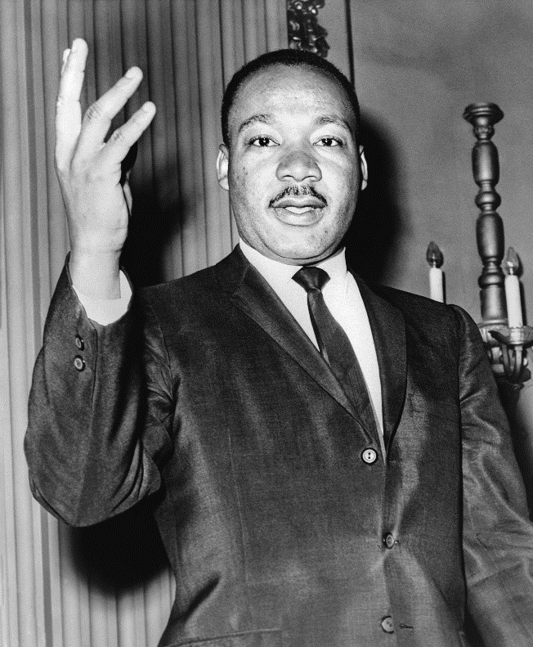
Competition Time!
The month of October celebrates Black History Month.
To celebrate this month Mr Fernandes is running a Spirited Arts competition for everybody at New Woodlands School.
The idea of this competition is to celebrate black culture and identity in the UK.
Either produce a poster/collage or written piece of work detailing who they think has had the biggest impact on black history in our life time.
In the past people have designed collages/written assignments on
Jesse Owens
Rosa Parks
Emmet Till
Martin Luther King
Marcus Rashford
The winners will receive a £10 gift voucher
Plan
Research
Create
Evaluate
The competition ends 6th November 2023. Please submit your work to Mr Fernandes

Slide 3
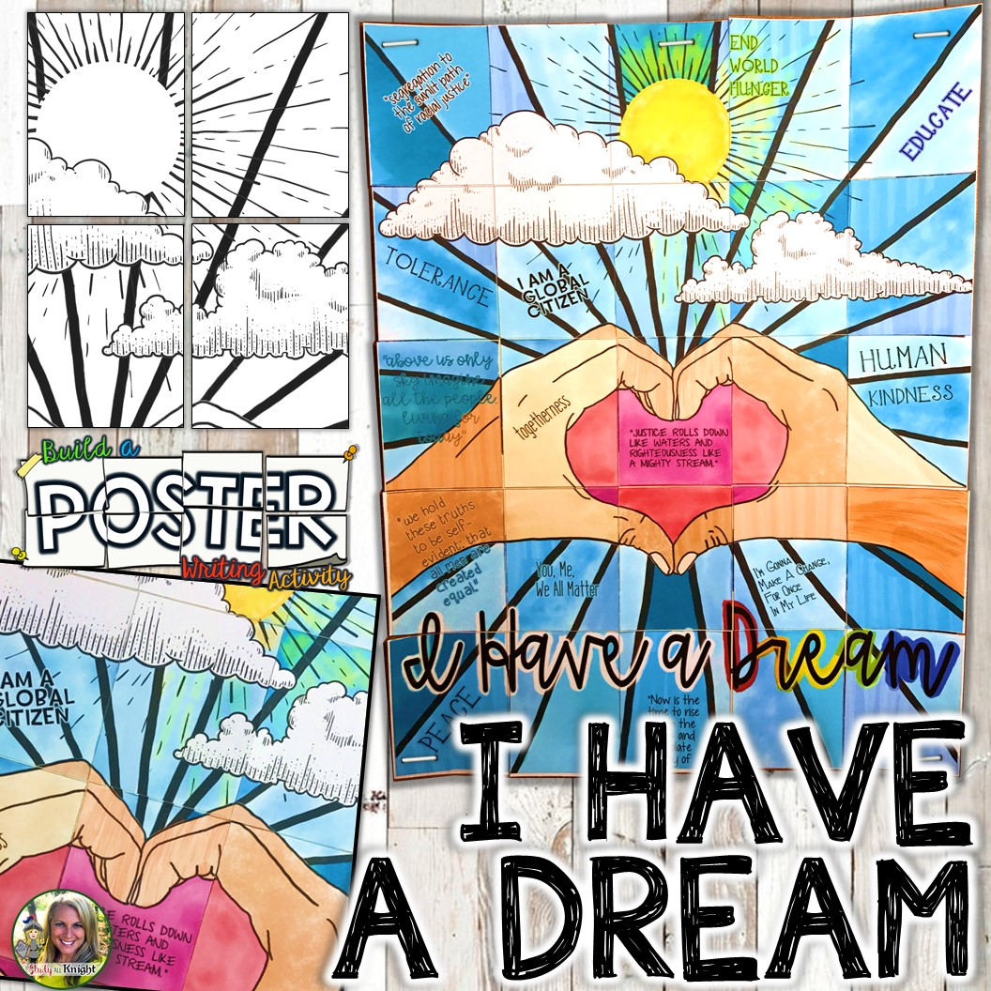
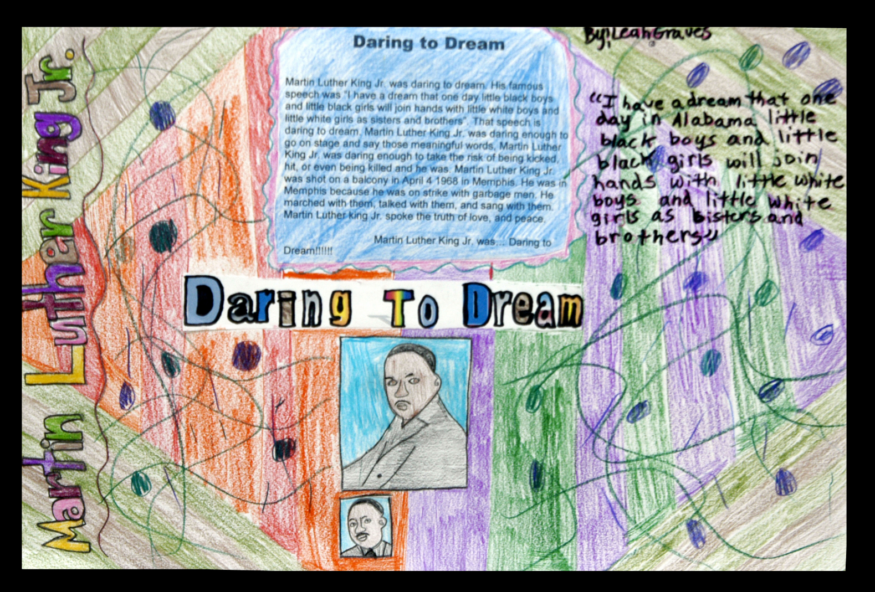
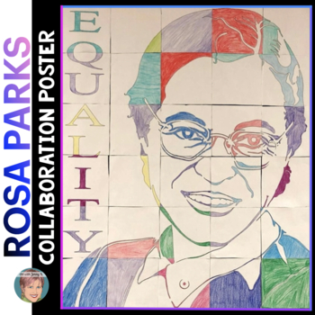
Examples of Posters

Slide 4

Key Dates
Key Dates:
The competition starts today
The competition ends 6th November
You will have 4 weeks to get your entry in.
It will judged by Mr Fernandes and the school council team
Your work may feature on the school website. Please make use of Twinkl for some fabulous resources.
Please visit Mr Fernandes in C6 Secondary Side for help with your entry.
I would like as many entries as possible so we can showcase your work!
Good Luck!

