Slide 1

Notes:
Hi We are Future Forward, a street-based project at Youth first.

Slide 2
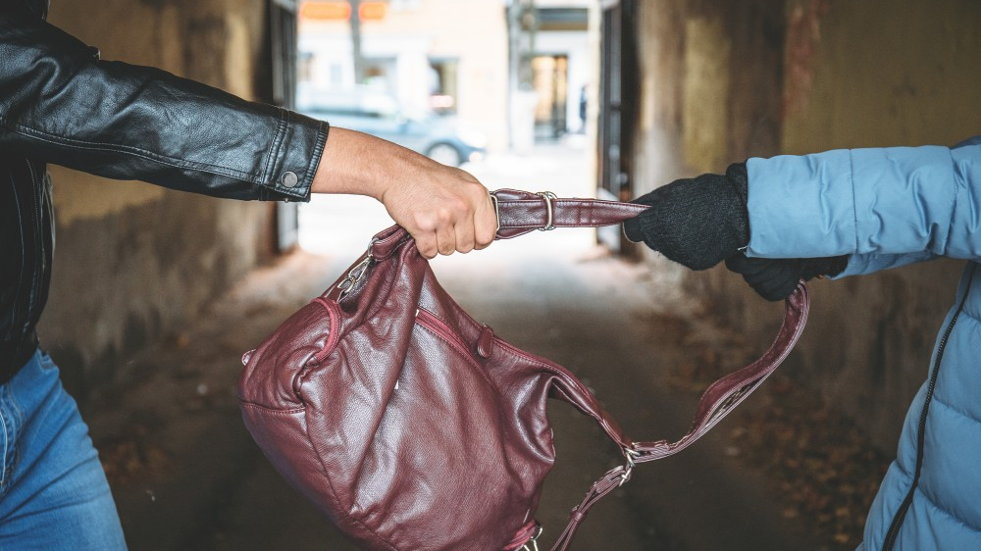
Street Robberies

Slide 3
Street Robberies
We are here to talk to you about
the rise of street robbery that is happening here in your community.
Especially in the borough of Lewisham.
Stop and ask yourself…
Why is this happening?
The truth is there isn’t always one answer
Why might people commit crimes such as street robberies?
Here are a few that come to mind…
Notes:
Unlike other jobs working with young people always makes me ask

Slide 4
Cause and Affect
Abuse
of
Power
Because you
can
Lack of support for others
Peer Pressure
Disfunction
in the family
Bullying
Banter
Cost of Living Crisis
Inner City Poverty

Slide 5
Let’s get technical !
Theft vs Robbery
Is there a difference between theft and robbery?
Theft means taking someone's property but does not involve the use of force
Robbery is taking someone’s property using force or making them think force will be used

Slide 6
Who might be affected by street robberies ?
You
Friends
Youth Workers
School Children
Local community
Family Members
Teachers

Slide 7
Food For Thought
Is This You?
At times, we won’t understand why You or Someone you know
would go out in the street one day and think
‘I should hurt somebody or rob somebody’s phone’.
You may have been the victim or be the perpetrator
Whatever side you're on you may feel invisible, we are not here to pass judgement.
However, we must address what is happening in
YOUR COMMUNITY

Slide 8
Why Me?
Being a target isn’t your fault!
Being a victim of theft is certainly not your fault!
It doesn’t change the fact that You or Someone you know has been a target
It can leave people feeling vulnerable, hurt and afraid!
An experience like that can change the way you see the world around you.

Slide 9
Invisibility
Let’s unpack this a little further…
Sometimes people feel unseen, young people just like you feel invisible.
When people feel unseen, they may do things in order
To gain
CREDIBILITY!

Slide 10
It’s Not My Problem
One thing we often hear is
“It’s not really my problem”…
Until it happens to your Neighbour, your Best Friend, your Cousin
Niece or Nephew
Your Siblings
Your Parents
or a little closer to home…
YOU!

Slide 11

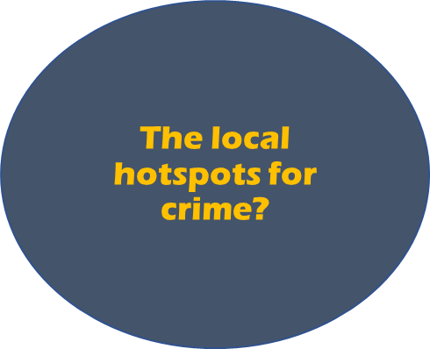

What items could someone want to rob from you?
What items could someone want to rob from you?
What are the local hotspots for crime?
Smartphone
Designer Items
Headphones
Money
Food
Town Centres
School Bus Stops
Food Shops
Teachers
Police
Youth Workers
Trusted Mentors
Friends

Slide 12

Street Wise

Slide 13
How to Protect Yourself From Street Robbery
Here are some useful ways to keep you and your property safe on the street.
Considering the following can make all the difference.
Be Vigilant
Be aware of your environment
Know where you are; is this a hot spot for crime
Plan alternative routes to avoid the risk of being targeted
Look confident
You are less likely to be targeted if you look confident.
Move with purpose and always be aware of your surroundings
Know where you’re going
Plan your route
Think about what to take with you; especially if you’re going somewhere you haven’t been before.
Walk in busy, well-lit streets, walkways and paths which are more likely to be covered by CCTV.
Only take licensed Ubers or minicabs booked by parents or a mobile phone app.

Slide 14
How to Protect Yourself From Street Robbery
Hide it
Keep your valuables out of sight.
If you’re using your phone, it’s more likely to be snatched from your hand as you’re not paying attention
Keep a look out.
Never leave a mobile, or any valuables at a far distance.
For example, you’re making a Tik Tok or Snapchat in a public place make sure your phone isn’t too far away from your reach.
Keep jewellery and valuable items covered/well-hidden when walking down the street.
Finally
And this is so important to remember – if you’re threatened with violence, don’t risk your personal safety.
Property can be replaced, You can’t

Slide 15
How long can you be jailed for committing a robbery?
What is an DBS?
If you’re under 18
A civil injunction can last up to 12 months
It's Not Worth It!!
Up to 8 Years Community Service or Sentence up to 5 years
Disclosure and Barring Service ( DBS ) check allows an employer to see your criminal history.
DBS checks are often carried out at the start of your employment, or just before an employer decides to hire you.
A CBO (Criminal Behaviour Order) lasts between 12 months and 3 years there’s no maximum amount of time if your over 18

Slide 16
Consequences
Being involved in street crime could end up with you being arrested, fined, reported and taken back to your home address where your parents will be spoken to, and they too could be at risk of penalties due to your behaviour and shown police footage or CCTV of your actions.

Slide 17
Your Community, Your Choice
It is easy to be unaware of how your behaviour impacts others
We have spoken about street robberies and how it affects your community.
We think it would be beneficial to highlight some of the positive things surrounding young people in the borough.

Slide 18
Youth engagement activities
The Albany
Website: https://www.thealbany.org.uk/get-involved/youth-programme
Age range: 5-25
Location: Douglas Way, Deptford, SE8 4AG
Midi Music Company (MMC)
Website: https://www.themidimusiccompany.co.uk/courses
Age range: 11-30
Location: 77 Watson’s Street, Deptford, SE8 4AU (although at present all their courses are run online)
Lewisham Youth Theatre (LYT)
Website: www.lewishamyouththeatre.com
Age range: 3-24
Location: The Broadway Theatre, Catford Broadway, London SE6 4RU
Youth First
Website: https://www.youthfirst.org.uk/programme
Age range: 8-18
Location: across Lewisham
Young Lewisham Project (YLP)
Website: https://www.younglewisham.org.uk/programmes.html
Age range: 11-19
Location: 124 Kilmorie Road, Forest Hill, SE23 2SR
Website: www.rycse23.co.uk
Age range: Junior Club 8-11, Senior Club 12-18
Location: 41a Rockbourne Road, Forest Hill, London, SE23 2DA

Slide 19
Questions?

