Slide 1

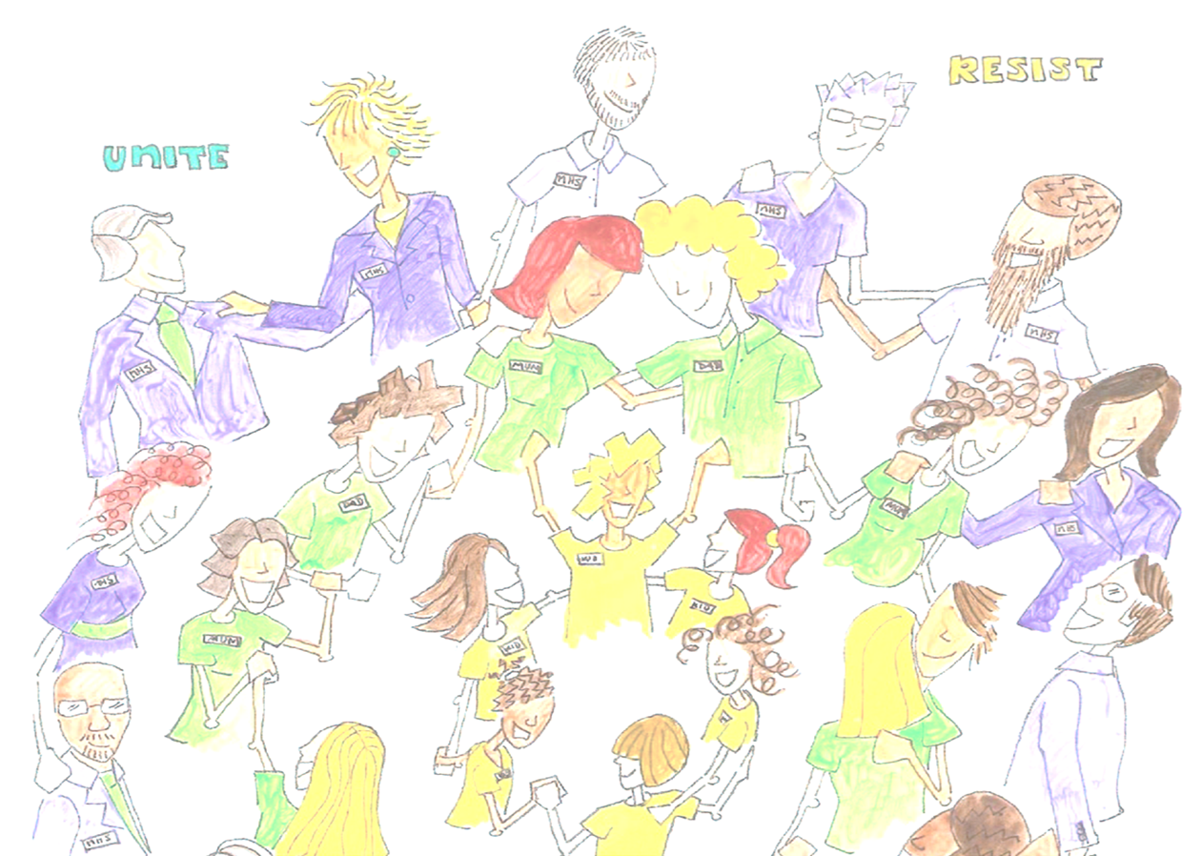
Non violent resistance programme (NVR)

Slide 2
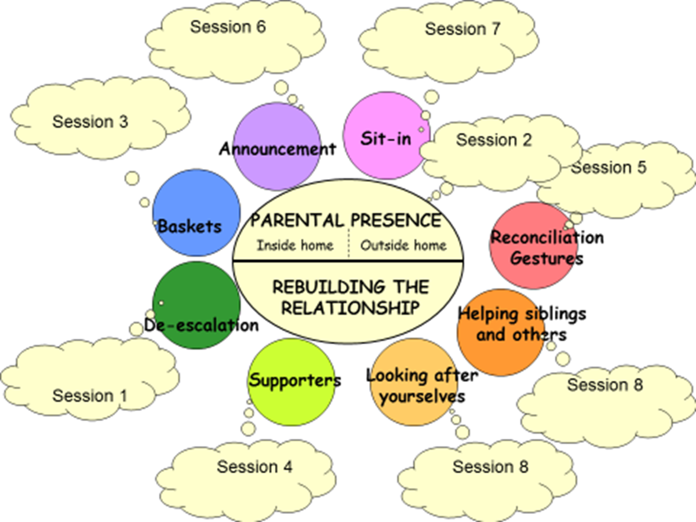
Sessions covered over the 8 weeks

Slide 3

The Aims of forums
Core aims are of NVR forums are to;
De-escalate and reduce conflict
‘Reclaim’ parent / carer space in family home
Not relenting to child’s unreasonable demands
Helping parent / carer to reach out, connect and rebuild their relationship with their child / young person
Notes:
to increase a parent’s ‘Parental Presence’ in family situations where children are displaying high levels of challenging behaviour such as- non-compliance, school-refusals, aggression, violence, destruction, criminal involvement, drugs.

Slide 4



For parents and carers
For parents / carers of children aged 8 years and over, displaying violent / challenging and extreme negative behaviours
For parents / carers who want change

Slide 5
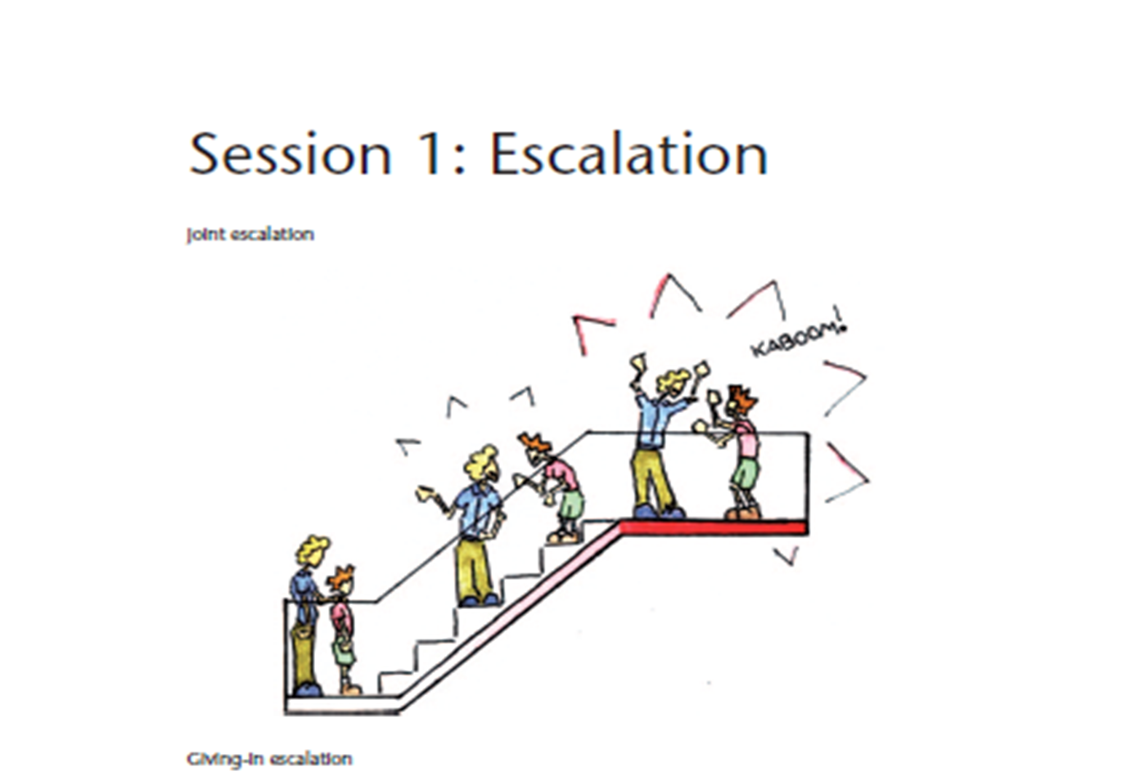
Session 1 – De-escalation
Session 1 is all about escalation and we cover the following;
Discussions around Escalation
What escalation is
Different types of escalation
Strategies to manage and prevent escalation

Slide 6

Session 2 – Parental presence / Influence and making connections
Session 2 is all about Parental presence and we cover the following;
Discussions around Being present in your child's mind to guide them
Connection before correction

Slide 7
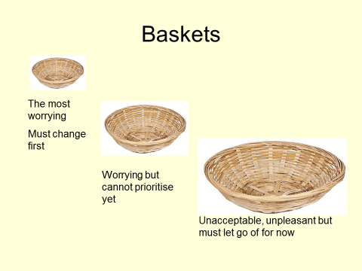
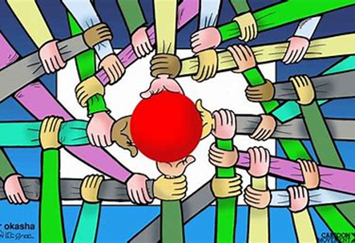
Session 3 – The baskets & Supporters
Session 3 is all about The baskets and we cover the following;
Naming behaviours
Prioritising behaviours
Identifying behaviours to work on
Sharing why we love and like our children
What a supporter does
How supporters can help with the small basket behaviours.
Own support needs
Obstacles and solutions to using supporters

Slide 8


Session 4 – siblings and self care
Session 4 is all about self care siblings and supporters we cover the following
The needs of siblings
Support for them
Looking after yourself
Importance of
How and when

Slide 9
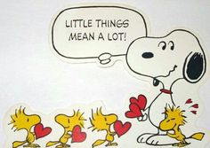
Session 5 –Parental values, reconciliation gestures / random acts of kindness and Connecting comments
Session 5 is all about Random acts of kindness and we cover the following
What are your parental values
  Where do they come from
Discussion of what are Acts of kindness are and how to do them
Discussion of how to separate behaviour from child
Discussion around Never expecting any gratitude

Slide 10
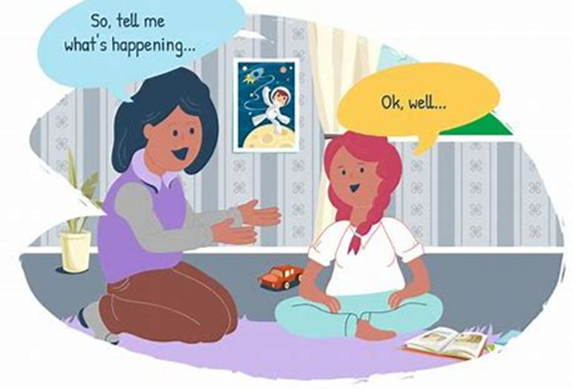
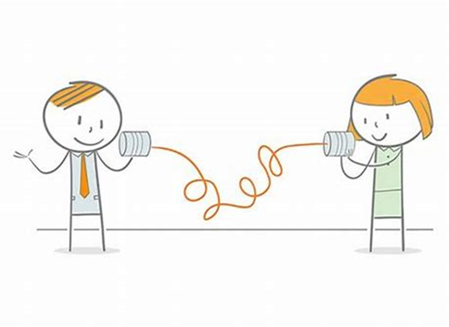
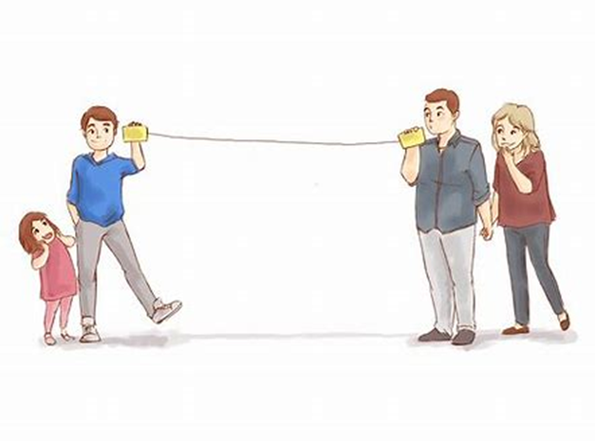
Session 6 resisting comments
Six pre planned connecting comments
What are they
How to deliver
Timing
Tone
Talk

Slide 11

Session 7 – Announcement
Session 7 is all about the Announcement and we cover the following
know what an announcement is and why its important
See how it is made
Know what a Self-announcement is
Make your own draft announcement

Slide 12
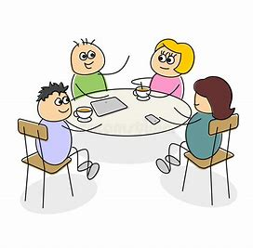

Session 8 – The sit in and celebration
Session 8 is all about the Announcement and we cover the following
Acts of resistance
What is a sit-in?
How to do a sit-in?
CAKE
Reviewing all aspects of NVR

Slide 13
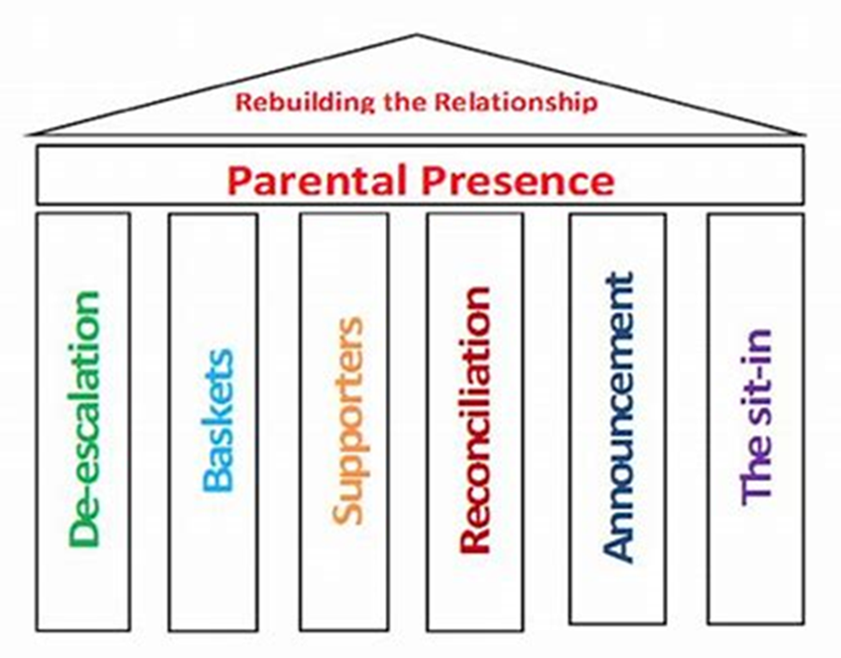
The NVR house is complete

Slide 14


NVR reminder
Violence (smacking, slapping, restraining, throwing )
Battles
Giving in
Punishment
Rewards
Giving up
Being Powerless
Winning or Losing

Slide 15

Thoughts
Is this course for you?

Slide 16

Contact details – NVR@lewisham.gov.uk
Lynn McShane 07392191294 / Lynn.McShane@lewisham.gov.uk
Charlotte Smith – 0208 314 6005 / charlotte.smith@lewisham.gov.uk

