Slide 1
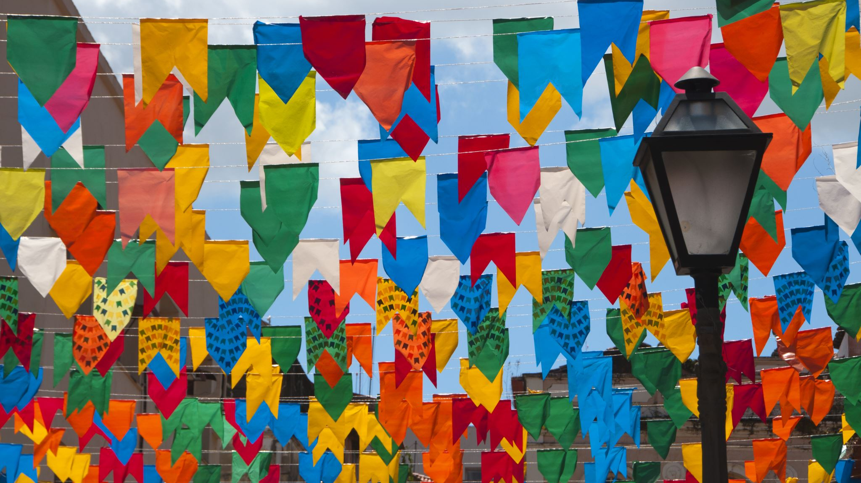
World Cup Flags

Slide 2
L/O: To design a World Cup Unity Flag
Create a flag that represents the coming together of nations through football.
Consider:
Patterns from other countries
National flowers
Landmarks
Textiles

Slide 3
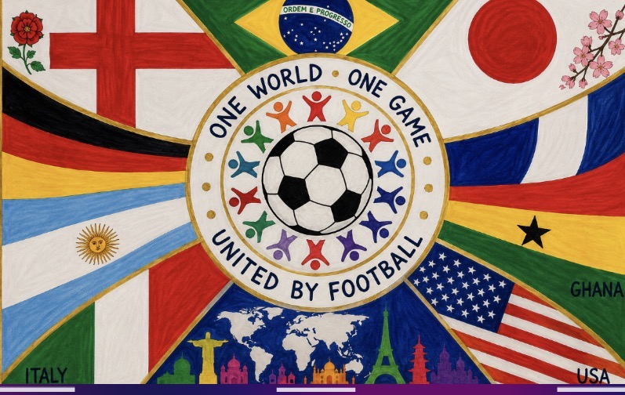

Slide 4
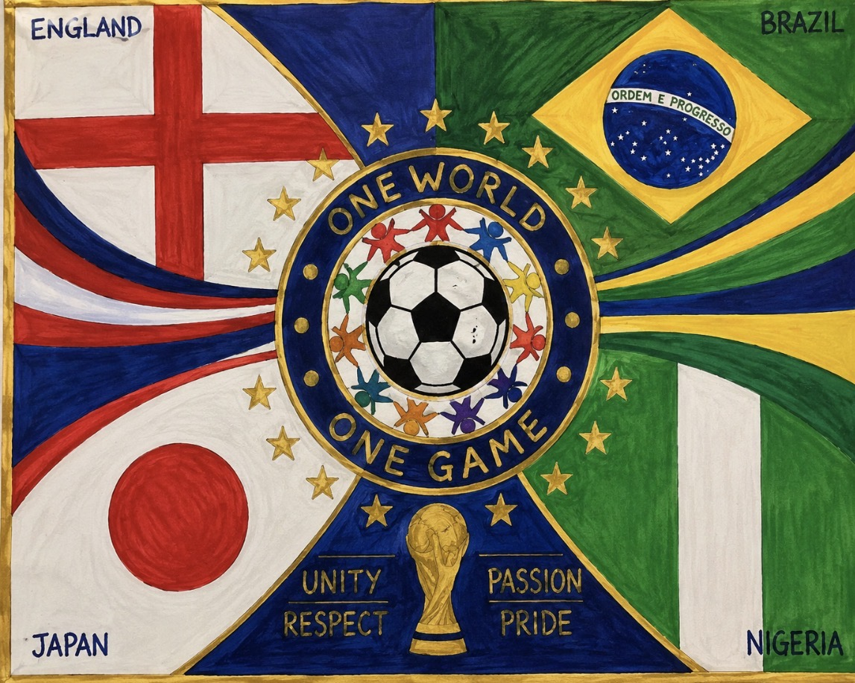

Slide 5

RED PEN REVIEW
Algeria

Slide 6

RED PEN REVIEW
Argentina

Slide 7

RED PEN REVIEW
Australia

Slide 8

RED PEN REVIEW
Austria

Slide 9

RED PEN REVIEW
Belgium

Slide 10

RED PEN REVIEW
Bosnia and Herzegovina

Slide 11
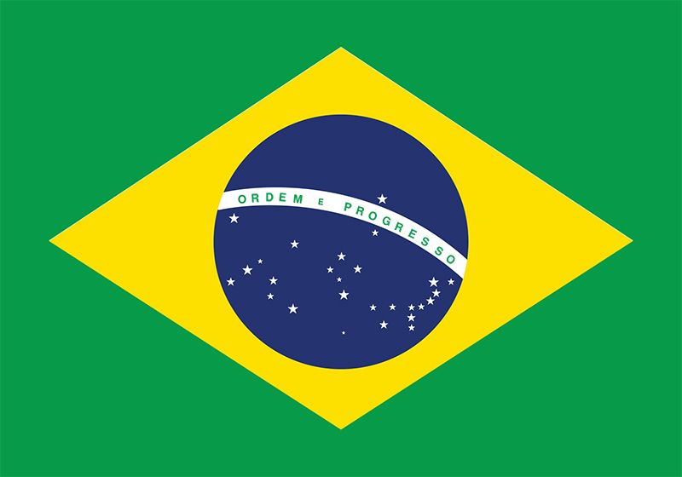
RED PEN REVIEW
Brazil

Slide 12

RED PEN REVIEW
Cabo Verde

Slide 13

RED PEN REVIEW
Canada

Slide 14
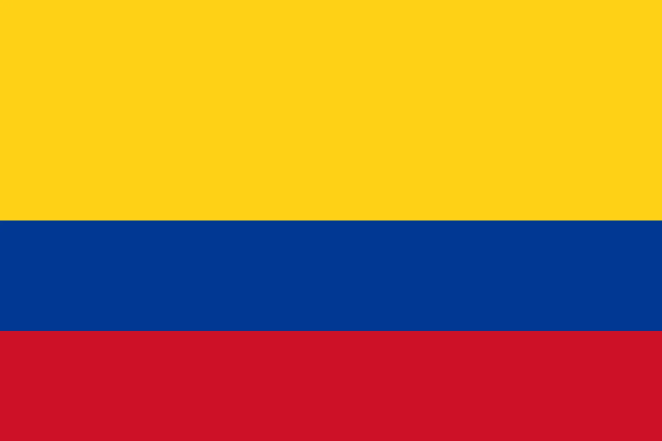
RED PEN REVIEW
Columbia

Slide 15

RED PEN REVIEW
Croatia

Slide 16

RED PEN REVIEW
Curaçao

Slide 17
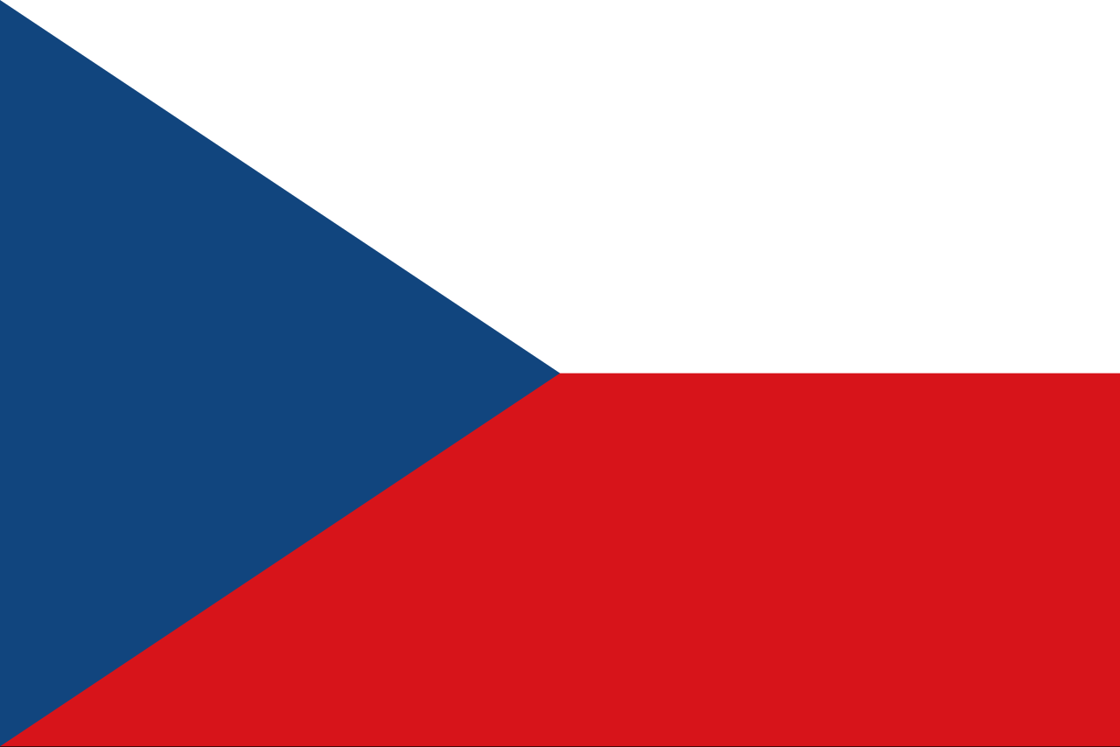
RED PEN REVIEW
Czech Republic

Slide 18

RED PEN REVIEW
Democratic Republic of Congo

Slide 19

RED PEN REVIEW
Ecuador

Slide 20

RED PEN REVIEW
Egypt

Slide 21

RED PEN REVIEW
England

Slide 22

RED PEN REVIEW
France

Slide 23

RED PEN REVIEW
Germany

Slide 24
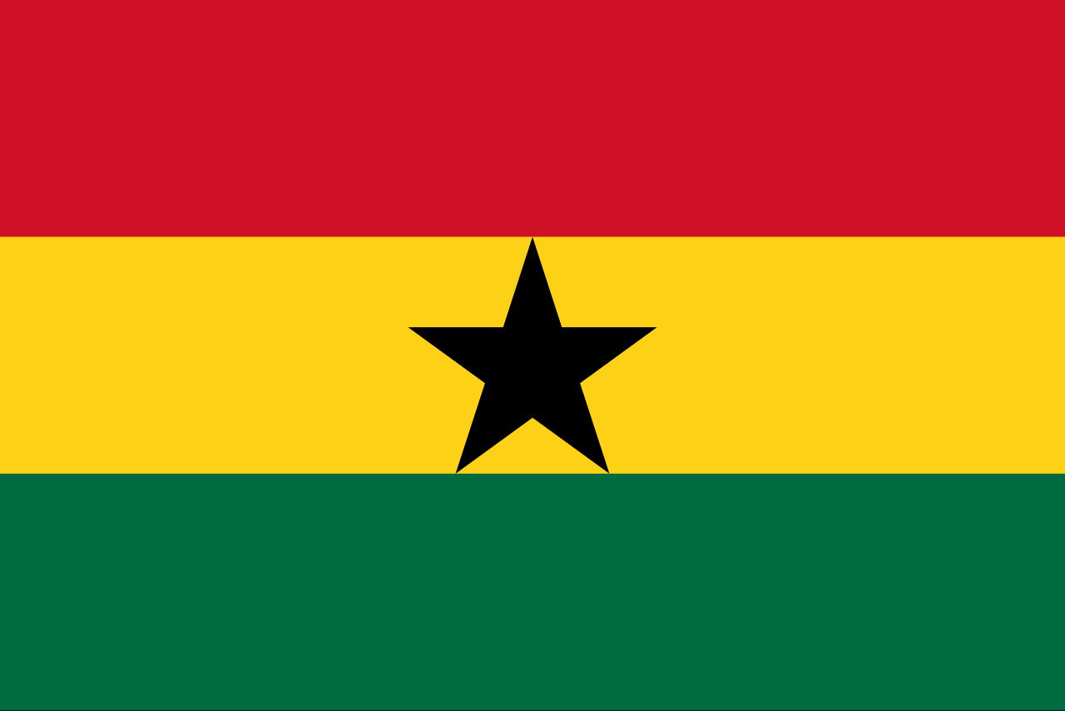
RED PEN REVIEW
Ghana

Slide 25

RED PEN REVIEW
Haiti

Slide 26
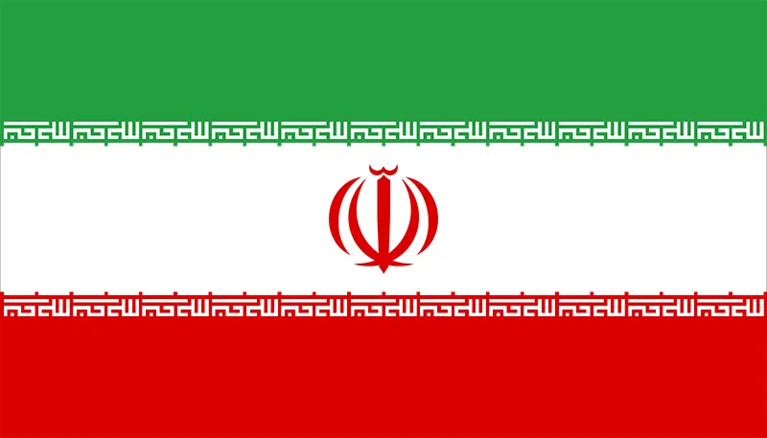
RED PEN REVIEW
Iran

Slide 27

RED PEN REVIEW
Iraq

Slide 28
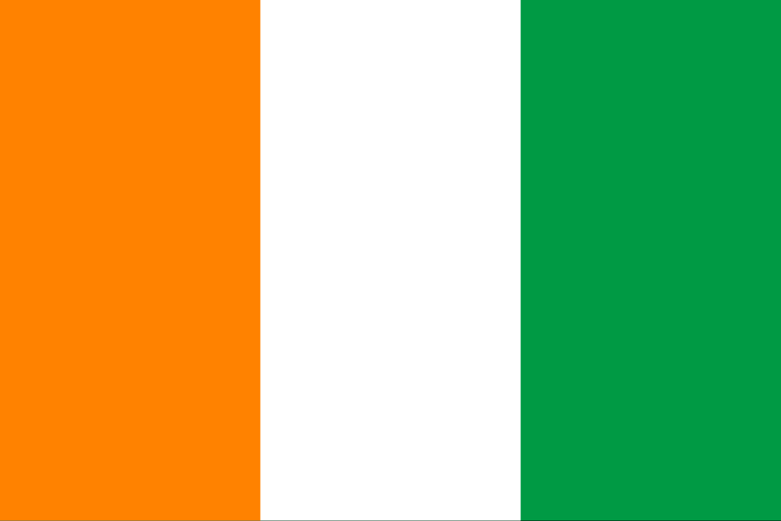
RED PEN REVIEW
Ivory Coast

Slide 29
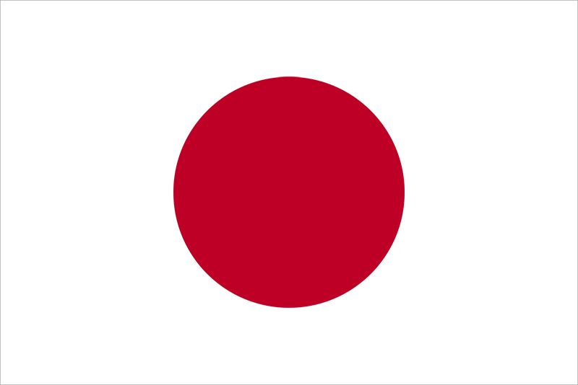
RED PEN REVIEW
Japan

Slide 30

RED PEN REVIEW
Jordan

Slide 31

RED PEN REVIEW
Mexico

Slide 32
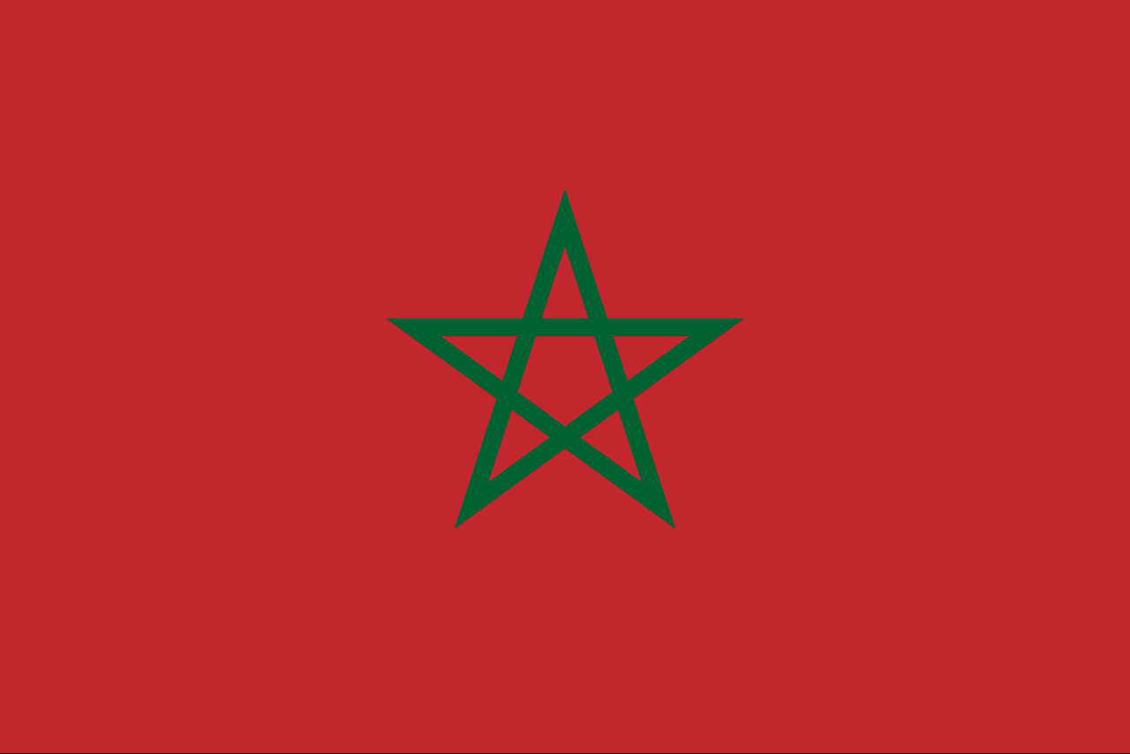
RED PEN REVIEW
Morocco

Slide 33

RED PEN REVIEW
Netherlands

Slide 34

RED PEN REVIEW
New Zealand

Slide 35

RED PEN REVIEW
Norway

Slide 36

RED PEN REVIEW
Panama

Slide 37

RED PEN REVIEW
Paraguay

Slide 38

RED PEN REVIEW
Portugal

Slide 39

RED PEN REVIEW
Qatar

Slide 40

RED PEN REVIEW
Saudi Arabia

Slide 41

RED PEN REVIEW
Scotland

Slide 42
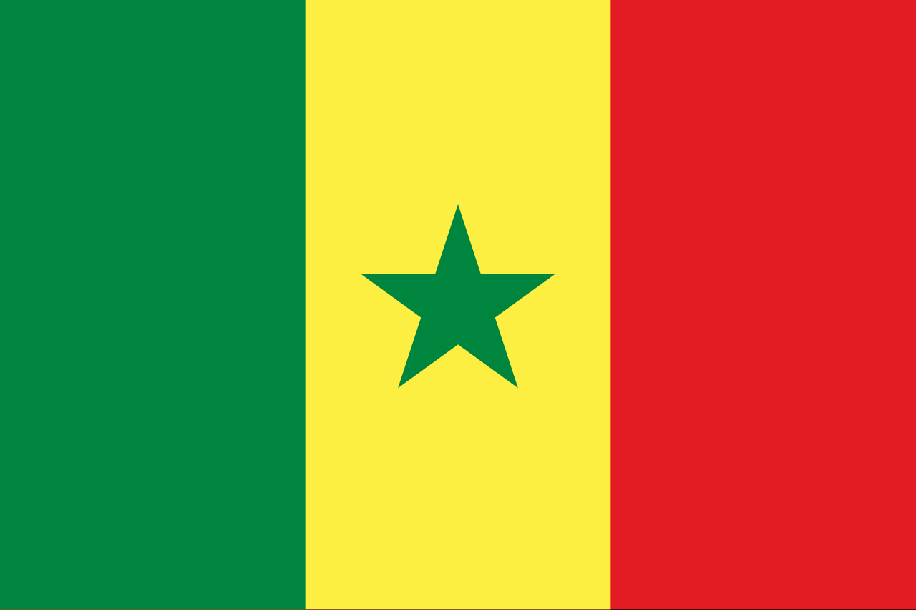
RED PEN REVIEW
Senegal

Slide 43
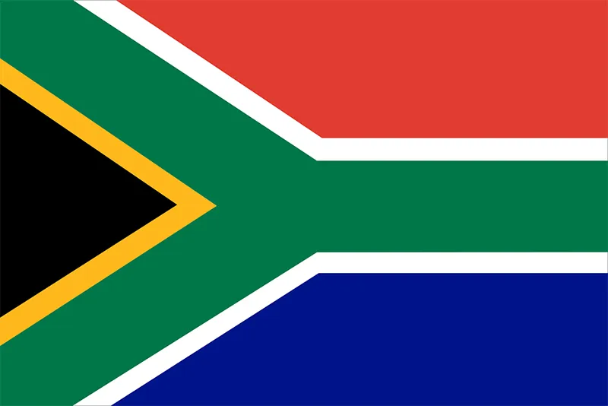
RED PEN REVIEW
South Africa

Slide 44
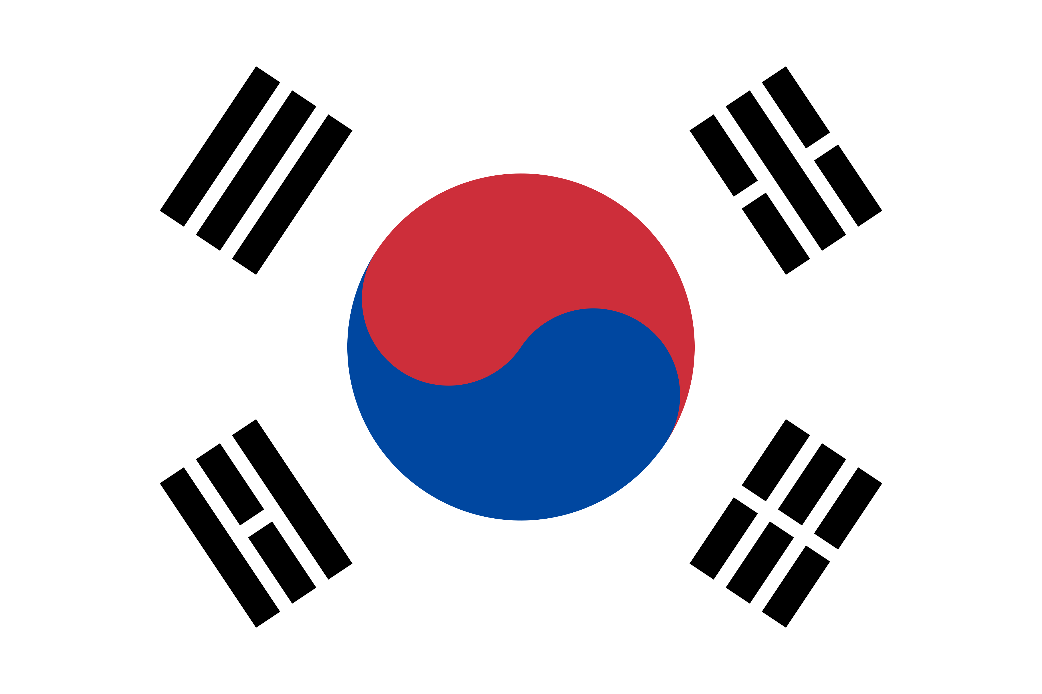
RED PEN REVIEW
South Korea

Slide 45

RED PEN REVIEW
Spain

Slide 46
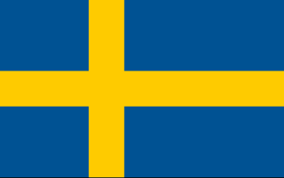
RED PEN REVIEW
Sweden

Slide 47

RED PEN REVIEW
Switzerland

Slide 48

RED PEN REVIEW
Tunisia

Slide 49

RED PEN REVIEW
Turkey

Slide 50
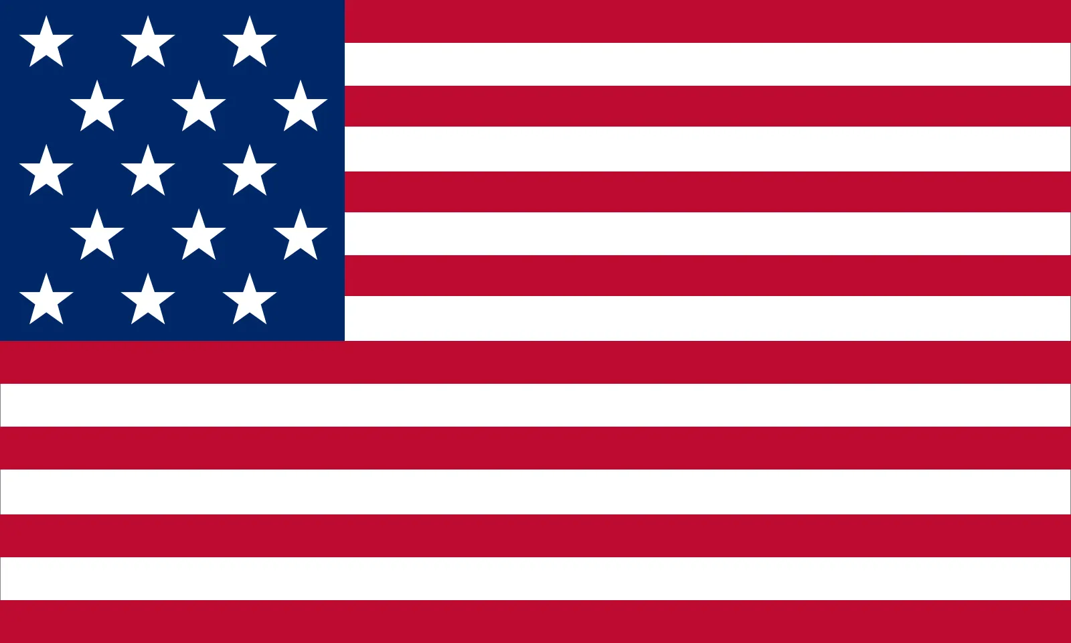
RED PEN REVIEW
United States of America

Slide 51

RED PEN REVIEW
Uruguay

Slide 52

RED PEN REVIEW
Uzbekistan

