Slide 1
My name is Ryan and my chosen career is…

Slide 2


Slide 3
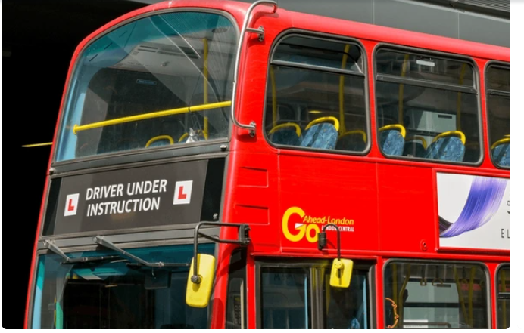
Bus Driver
A bus driver, also known as a coach or minibus driver, transports passengers to and from various destinations by bus or coach. Bus drivers are responsible for the safety and comfort of their passengers, and may also perform other duties such as: collecting fares, assisting passengers, providing route information, and conducting vehicle safety checks

Slide 4
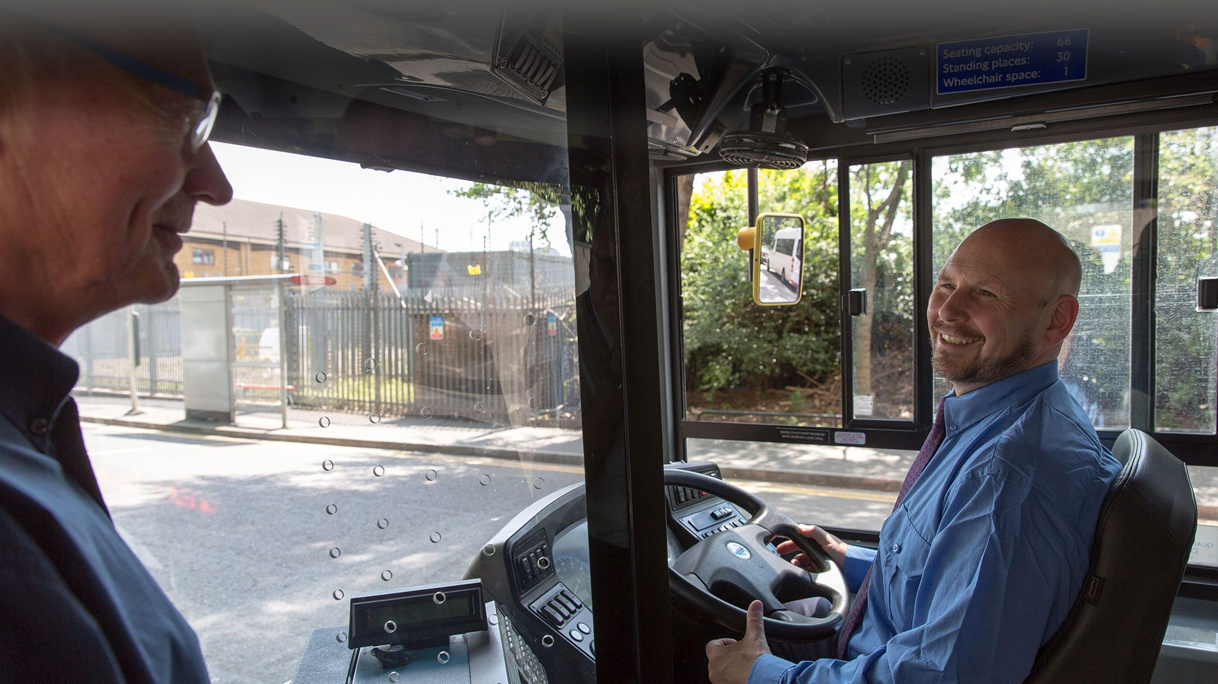
Bus Driver
Qualifications needed for a bus driver:
Be at least 18 years old (21 for interstate driving)123.
Obtain a Class B Commercial Driver's License (CDL) by passing a written exam and a driving test1.
Pass a medical test4.
Apply for a provisional Category D license4.
Complete theory and practical tests to obtain a Certificate of Professional Competence.
Obtain a passenger endorsement (required for all bus drivers) and a student endorsement (required for school bus drivers)5.
You can become a Bus Driver at 18 Years old.
£14,000 to £17,000 per year.
The average starting salary for a bus driver in the UK ranges from £14,000 to £17,000 per year.
The salary varies depending on location and industry1. More experienced bus drivers can earn up to £30,458 per year2.

Slide 5


